Slide 1
Emotion

Slide 2
happy, sad, angry, joyful, moping,
nervous, mad, bo red, irate
content,
rag i ng, awestruck, infatuated
doubtful, sorrowful,
Seething, brave, timid,
terrified, resentful, heart-broken,
elated, agreeable, scared, jealous,
exhausted, furious, grief-stricken, sorrowful,
captivated, disappointed, anxious, disgusted,
frustrated, surprised, enthralled, depressed
(550 words)

Slide 3
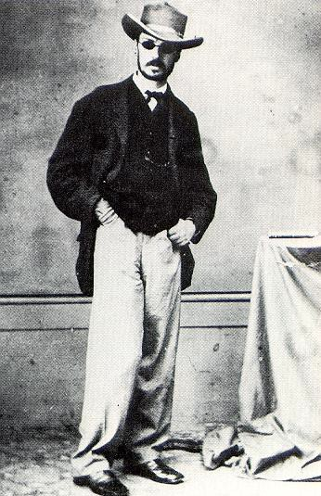

William James
1842 - 1910
This image is in the public domain.

Slide 4
Definition of Emotion
Emotions are biologically-based responses to situations that are seen as personally relevant. They are shaped by learning, and usually involve changes in peripheral physiology, expressive behavior, and subjective experience.

Slide 5
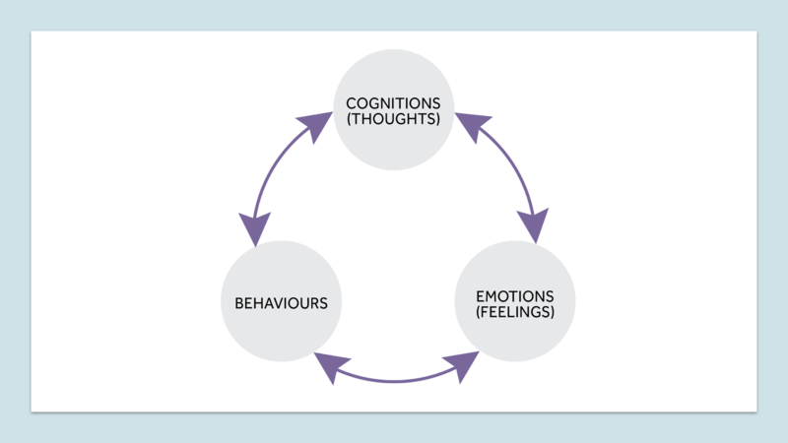

Slide 6
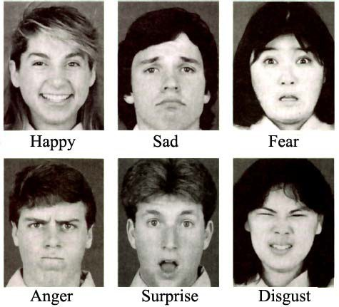
Six Basic Emotions
© Paul Ekman. All rights reserved. This content is excluded from our Creative Commons license. For more information, see http://ocw.mit.edu/fairuse.

Slide 7
EMOTION vs. MOOD
Mood - diffuse, long-lasting emotional states
Emotion - immediate responses to a specific object or situation

Slide 8
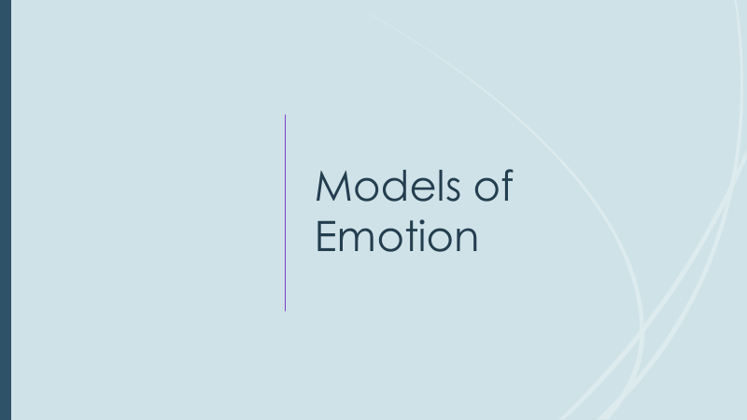

Slide 9
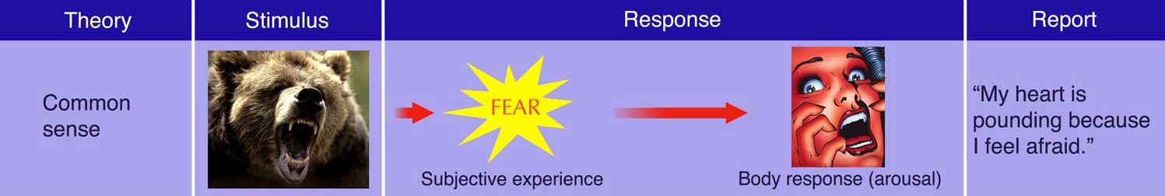
© source unknown. All rights reserved. This content is excluded from our Creative Commons license. For more information, see http://ocw.mit.edu/fairuse.

Slide 10
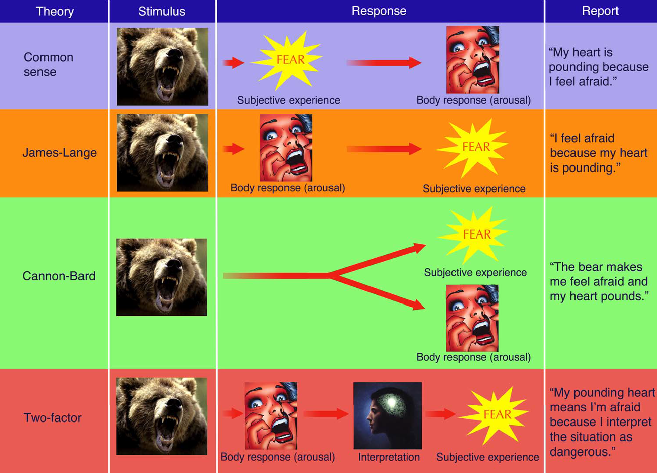
ψ
© source unknown. All rights reserved. This content is excluded from our Creative Commons license. For more information, see http://ocw.mit.edu/fairuse.

Slide 11

Emotions in Infants
Early Displays of Emotion:
Infants display emotions that are distinguishable and similar to facial displays among adults such as joy, disgust, surprise, sadness, anger, and fear.

Slide 12
Emotions Across Cultures
“A smile means friendship to everyone?”

Slide 13
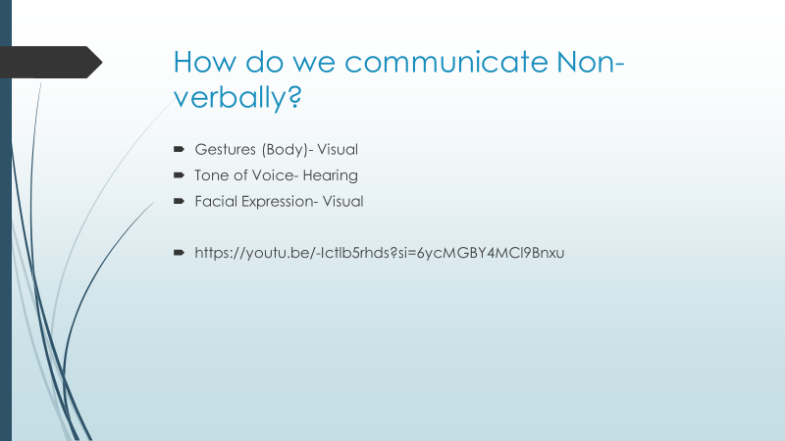

Slide 14
Functions of Emotions
Preparing us for action
Shaping our future behavior
Helping us interact more effectively with others

Slide 15
Motivation

Slide 16
What is motivation?
A need or desire that energizes and directs behavior

Slide 17
Perspectives on motivation
Evolutionary perspective (formerly ‘instinct theory’)
Drive reduction theory
Arousal theory
Hierarchy of needs

Slide 18
Instincts
Inborn patterns of behavior that are biologically determined rather than learned.
People and animals are born with preprogrammed
sets of behaviors essential to their survival.
Instincts play important role in directing our
behavior.

Slide 19
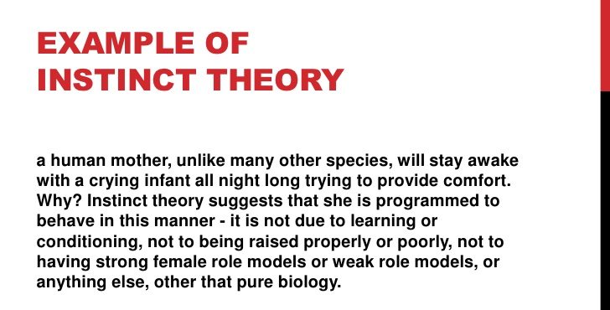

Slide 20
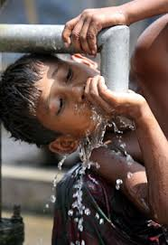
Drive-Reduction Theory
Theories suggesting that a lack of some basic biological requirements
such as water, produces a drive to obtain that requirement (in this
case, the thirst drive).
Drive
Motivational tension,
or arousal, that energizes
behavior to fulfill a need.
Example: hunger,
thirst, sleepiness, sex.

Slide 21
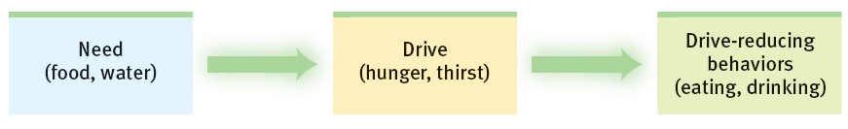

Slide 22
Homeostasis
The body’s tendency to maintain a steady internal state.
Example- Temperature too high: Expansion of blood vessels in skin, Sweating.
The concept homeostasis suggests internal motivating factors arise from a need to maintain a constant internal environment. The brain senses deviations from healthy set points and is driven to correct imbalances. If the body becomes short of water or nutrients, for example, the individual is driven to seek them.

Slide 23


Arousal Approaches
The Arousal Theory of Motivation suggests that people are driven to perform actions in order to maintain an optimum level of physiological arousal. Arousal can be stimulated by any number of things or actions, but it always results in higher or lower motivation.

Slide 24
When your arousal level drops below your optimal threshold, you become demotivated until your arousal spikes. Meaningful work, a night out with friends, or a fun new activity are all things that can spike arousal and therefore motivation.
For example, if you become demotivated at work, you might spike your mental alertness by taking on new and complex tasks, which in turn motivates you to work harder and get that promotion you deserve.

Slide 25
If your mental alertness becomes too high, you also become demotivated until your arousal drops back to your desired level.
If you become overstimulated your mental alertness can spike too high, which decreases performance and motivation.
For example, if you're working hard on the job and taking on tasks that are new and complex, you may become overstimulated and burn out. To combat this, you might take a long weekend to recharge, giving yourself time to lower your arousal back to optimal levels.

Slide 26
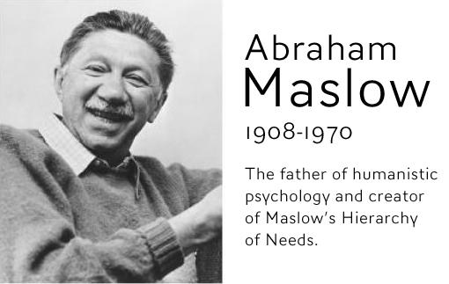

Slide 27
Maslow’s Hierarchy of Needs
This theory created by Abraham Maslow is based on how humans are inspired to satisfy their needs in a hierarchical order. Starting from the bottom going upwards, the five needs are physiological, safety, love and belonging, esteem, and self-actualization.
Applying Maslow’s Hierarchy of Needs
When you apply Maslow's hierarchy of needs in your life, you may experience improvements in some areas. To reach the highest level of development in this motivational theory, you must be self-actualized. Identifying your needs and ensuring that those needs are fulfilled can help increase your chances of success.

Slide 28
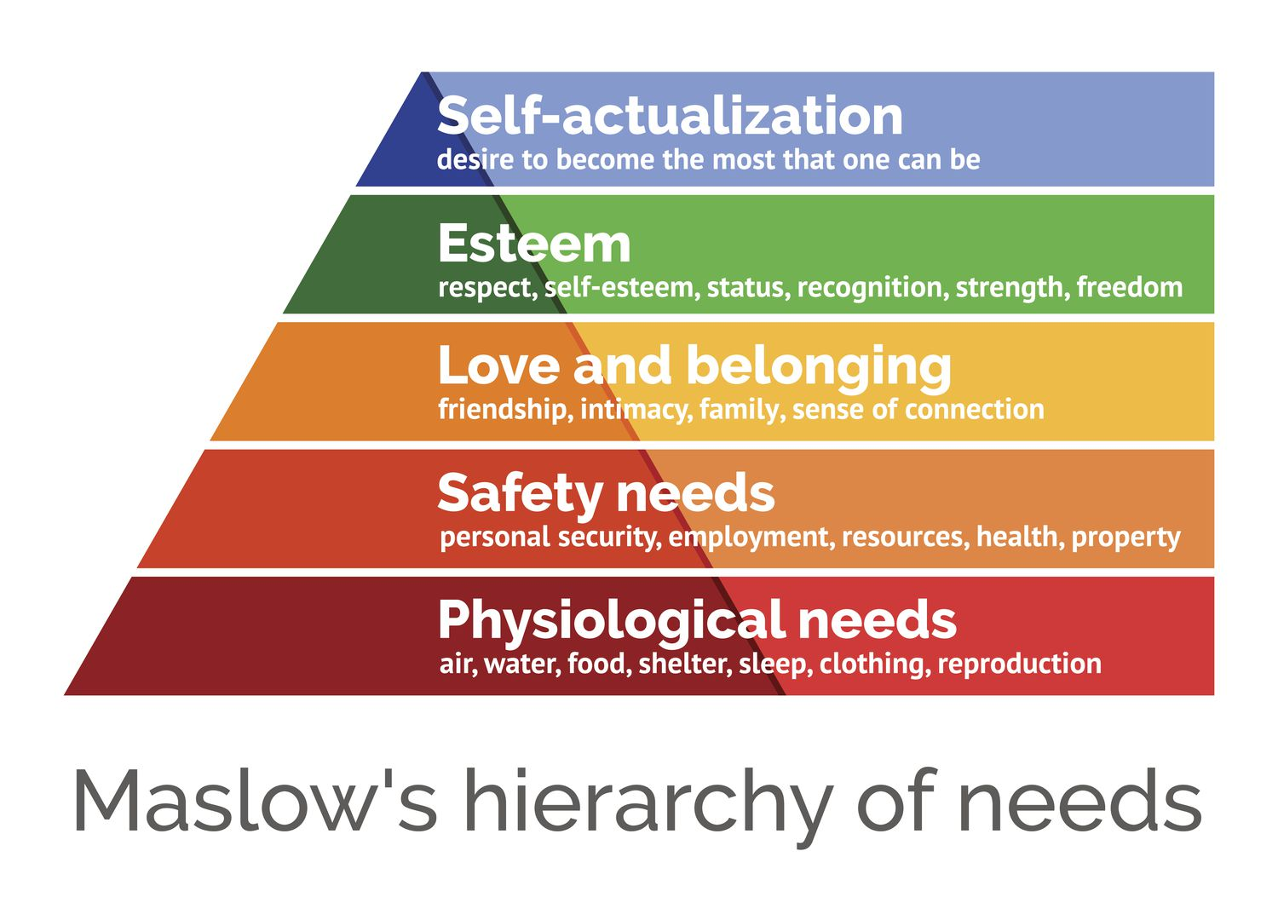

Slide 29
Maslow’s Hierarchy: Ordering Motivational Needs
Maslow’s hierarchy suggests that there are five basic needs:
physiological
safety
love and belongingness
esteem and
self-actualization
Only after the more basic needs are fulfilled can a person move toward meeting higher-order needs.

Slide 30
Cont…
1. Biological and Physiological needs - air, food, drink, shelter, warmth, sex, sleep.
2. Safety needs - protection from elements, security, order, law, stability, freedom from fear.
3. Love and belongingness needs - friendship, intimacy, affection and love, - from work group, family, friends, romantic relationships.

Slide 31
Cont…
4. Esteem needs - achievement, mastery, independence, status, dominance, prestige, self-respect, respect from others.
5. Self-Actualization needs - realizing personal potential, self-fulfillment, seeking personal growth and peak experiences.

